Slide 1
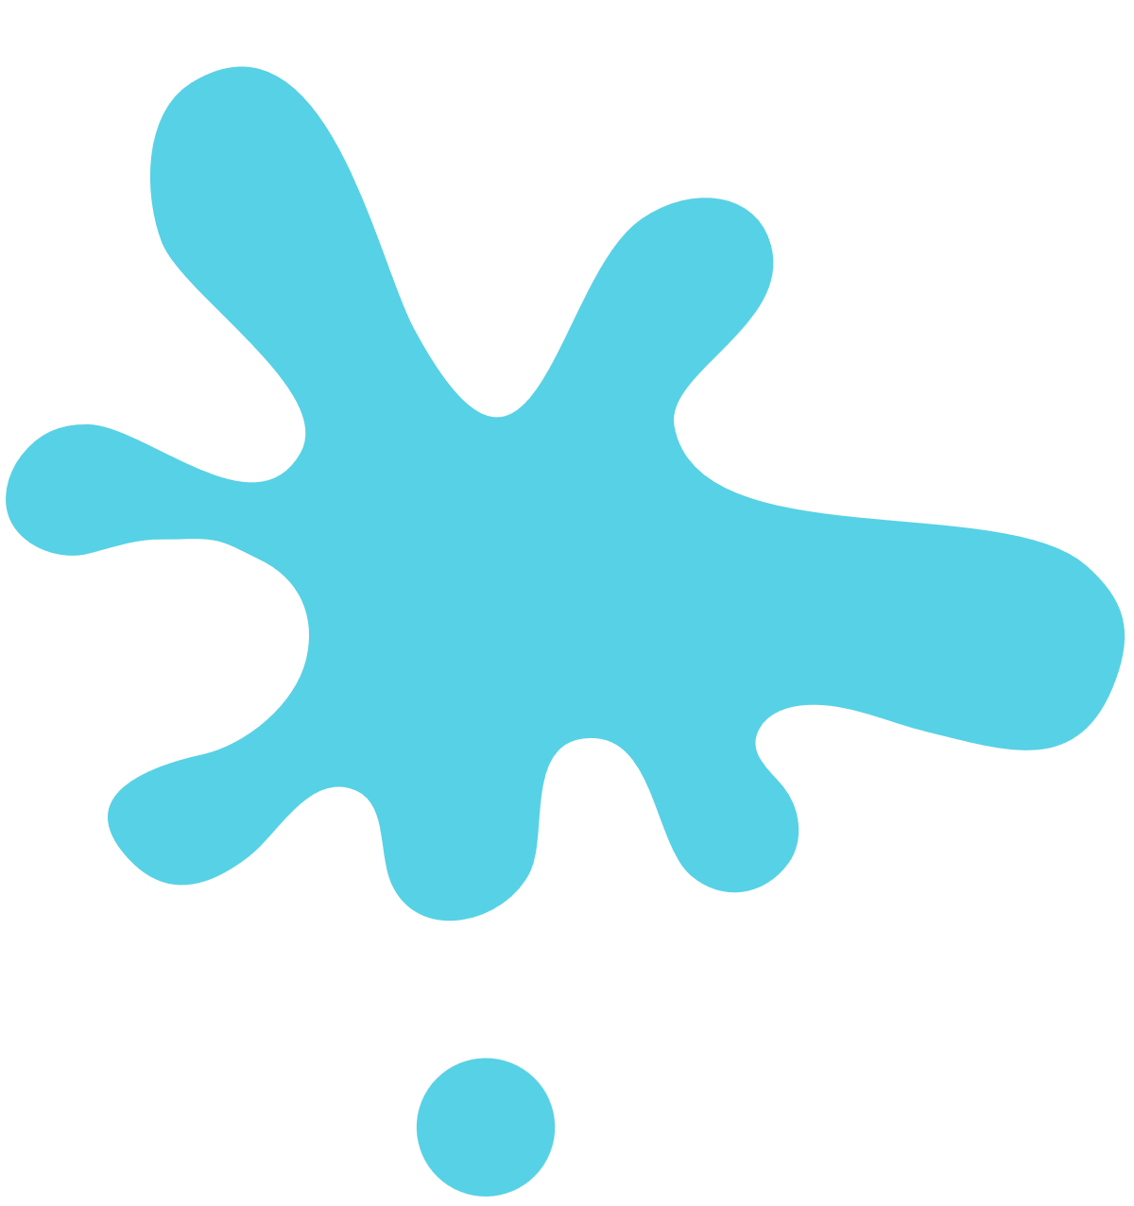


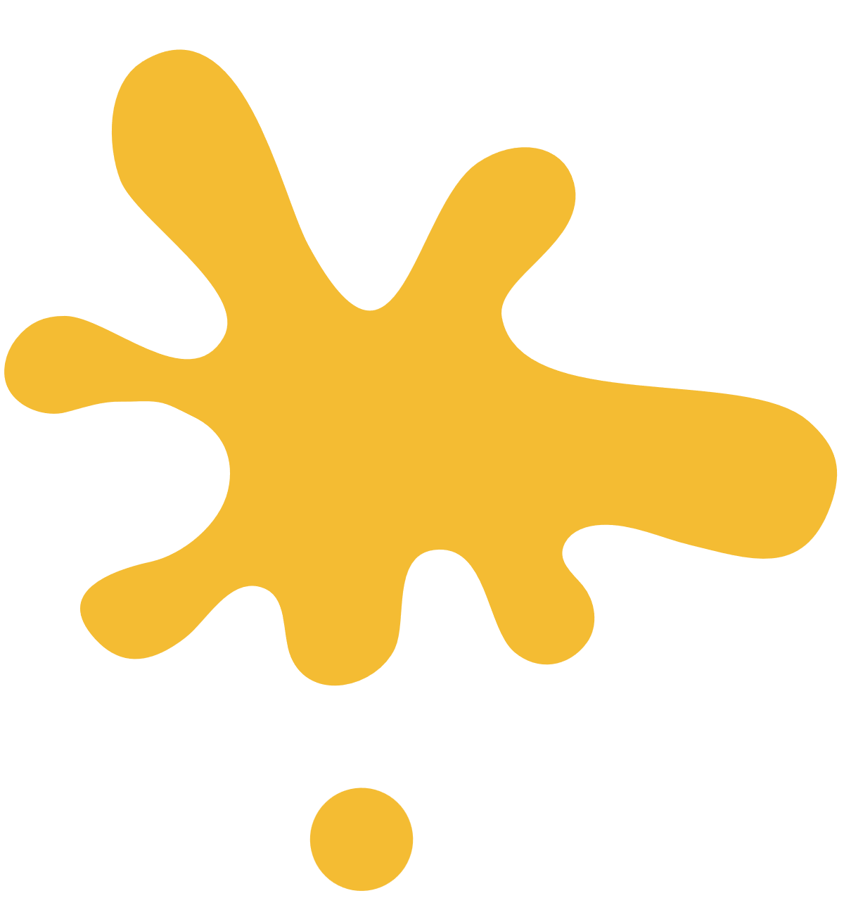



virtual
canvas
cv project

Slide 2
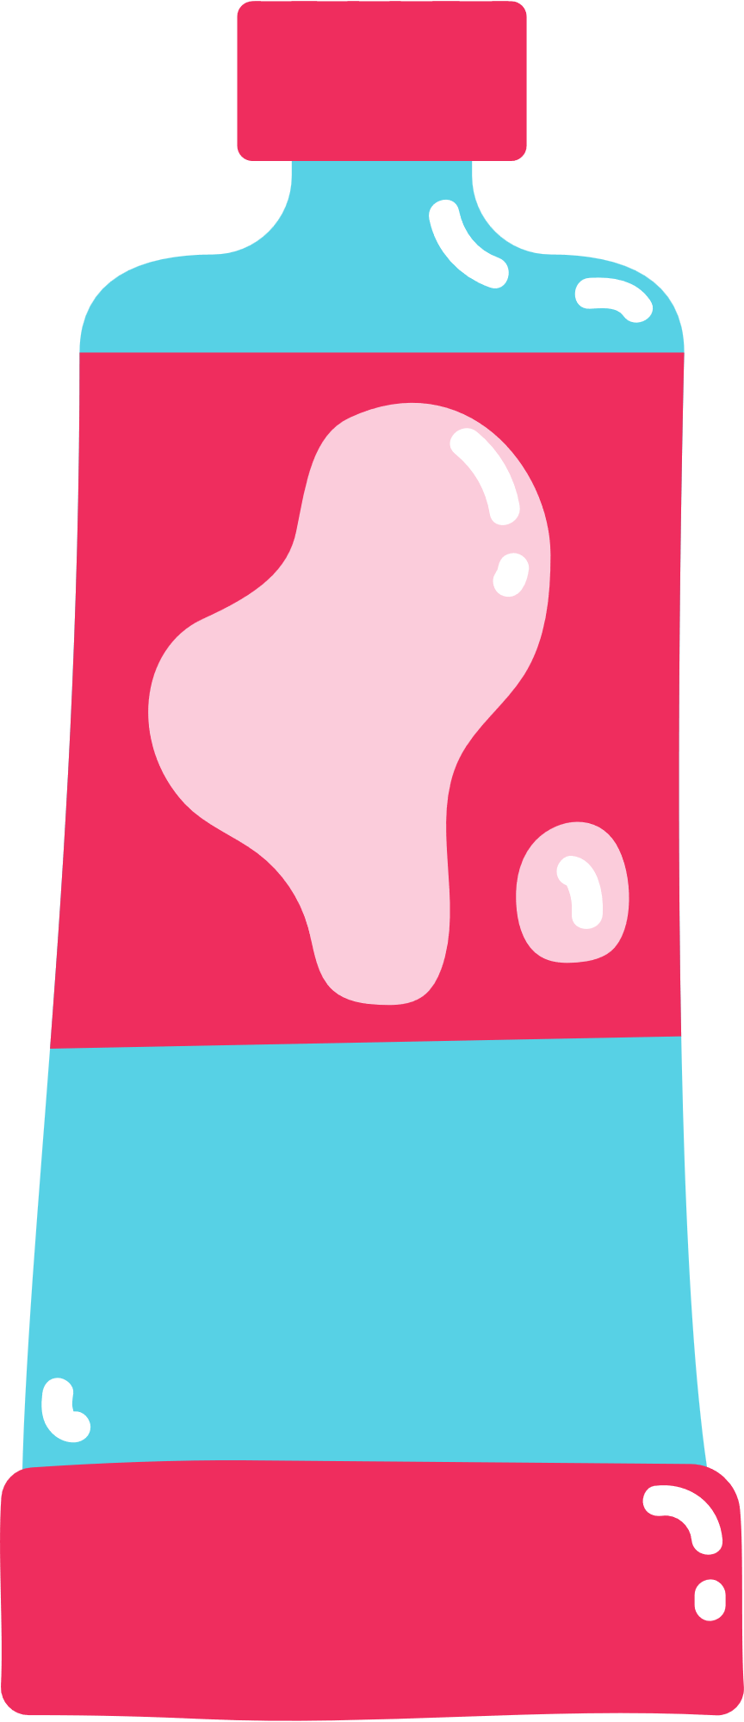

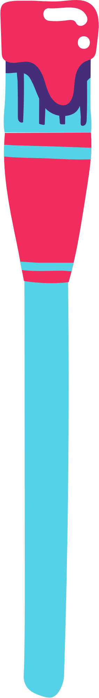
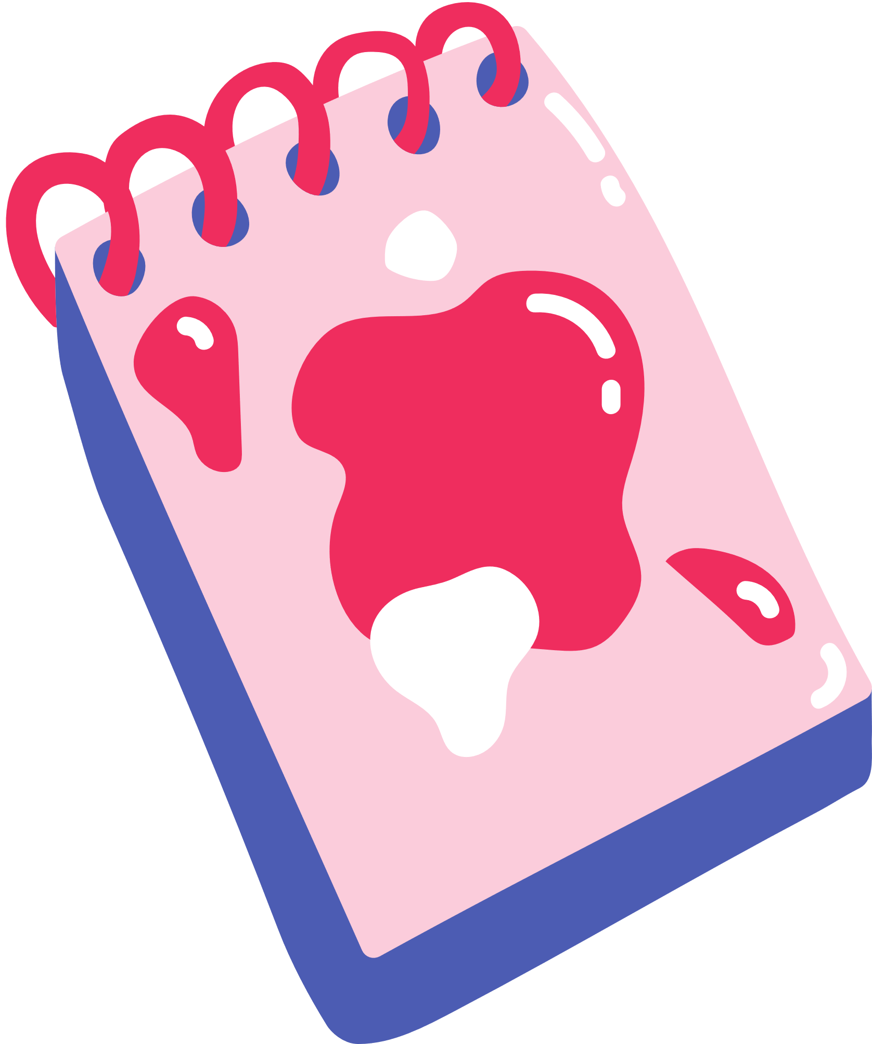
Introduction
This project demonstrates an interactive and intuitive way to create digital drawings using hand gestures, leveraging the capabilities of OpenCV and MediaPipe. The system tracks hand movements in real-time using computer vision techniques, allowing users to draw, change colors, and switch between different shapes—entirely hands-free.
By combining hand detection, landmark recognition, and gesture interpretation, the project creates a dynamic virtual canvas for expressive drawing

Slide 3

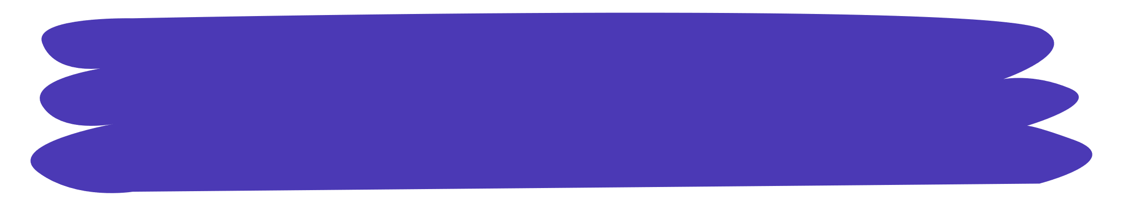
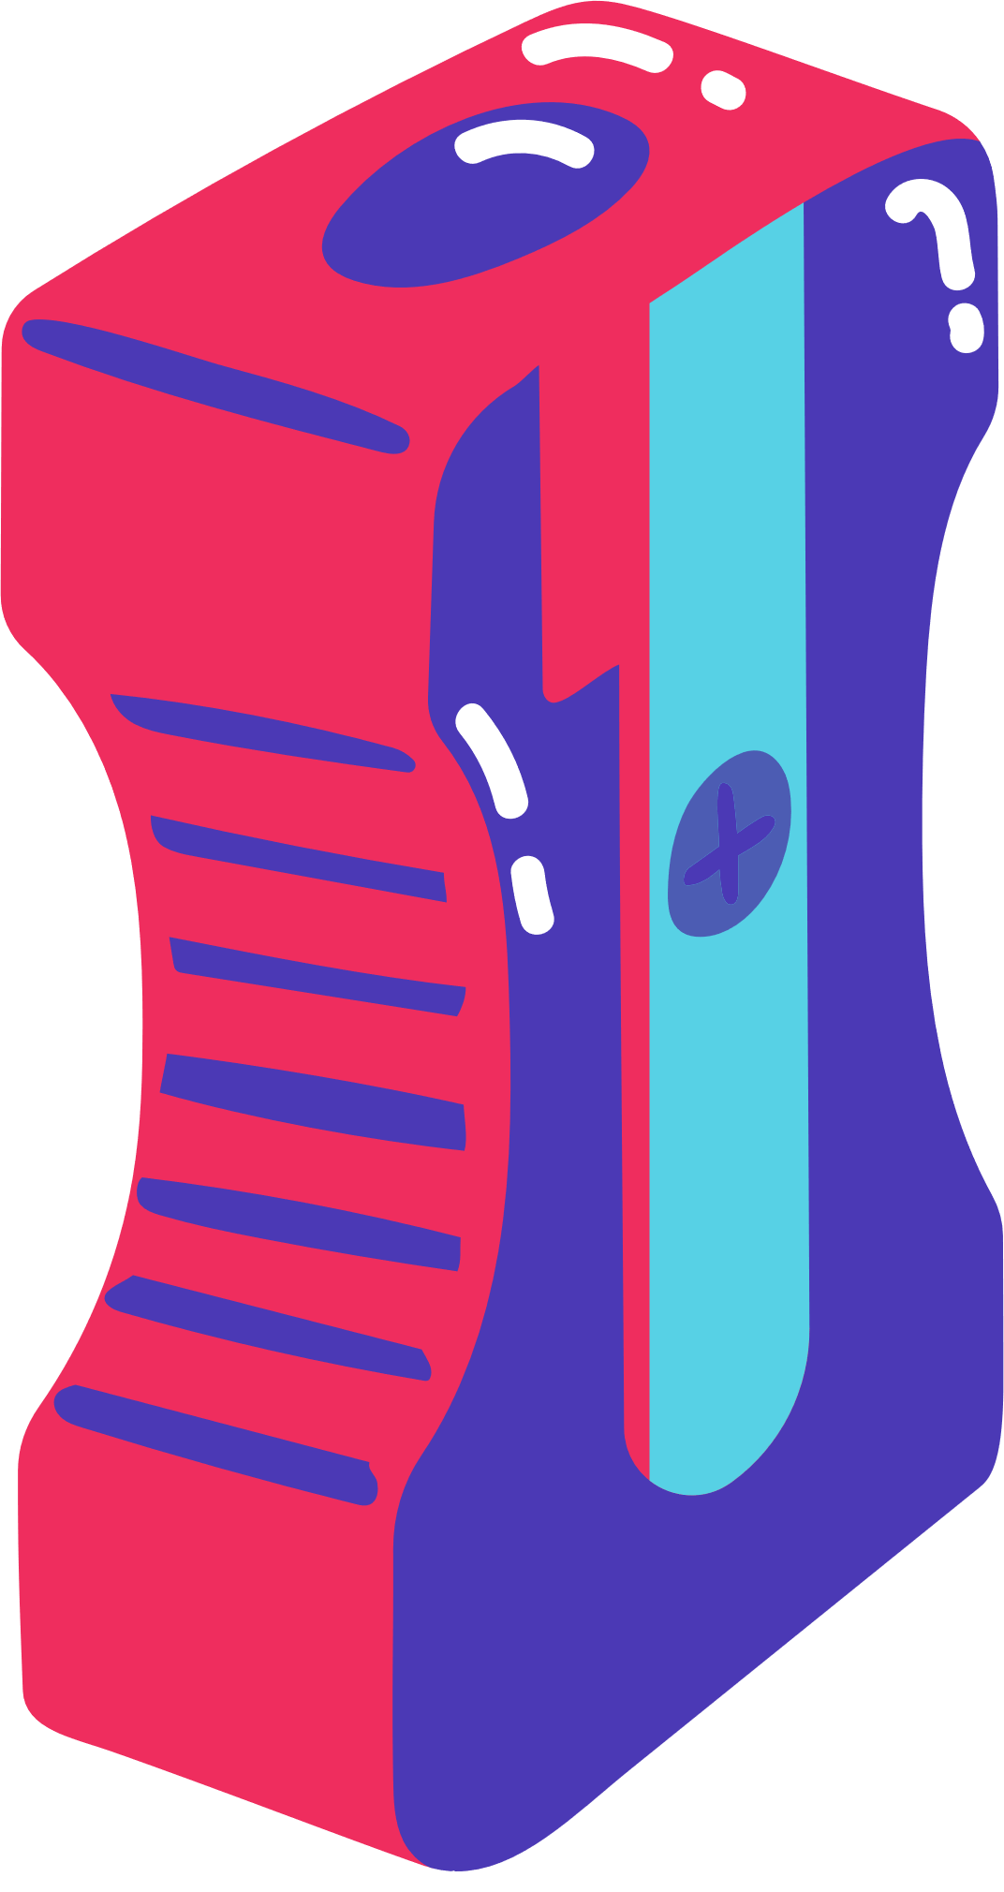
Tools and Libraries
OpenCV: An open-source computer vision library used to capture video from the webcam, process images, and create the drawing canvas.
Media Pipe: A machine learning framework developed by Google, offering high-quality hand tracking.
NumPy: A fundamental library for scientific computing with Python, used here to create and manipulate the arrays.
OS Library: This library facilitates interaction with the operating system, specifically for loading image assets from directories for the project’s dynamic header and icon display.

Slide 4

Project Overflow
Setup and Initialization
Hand Detection and Landmark Extraction
Begin by importing necessary libraries: OpenCV for image processing, MediaPipe for hand tracking, and NumPy for creating a drawing canvas.
Loading Overlays and Headers
A custom HandTrackingModule is used to initialize MediaPipe's hand detection model.
For each frame, the findHands method detects and tracks hands, and findPosition extracts landmark positions for fingertips, using these to determine gestures.
Use the OS library to load images from the "Headers" folder. These images serve as toolbar icons and color/shape selectors.
Display the default header initially, and update the header dynamically based on user interactions.

Slide 5
Project Overflow
Gesture Recognition for Mode Selection
Drawing on the Canvas
Selection Mode: Detect two raised fingers (index and middle fingers) to enable the color/shape selection mode.
Drawing Mode: If only the index finger is raised, switch to drawing mode, using the fingertip position to draw on the canvas.
In Drawing Mode, track fingertip position and draw continuous lines on the imgcanvas by connecting previous (xp, yp) and current (x1, y1) positions.
Use different colors based on the selected drawColor
Toolbar Interaction
In Selection Mode, if the hand is near the toolbar, recognize the horizontal position (x-coordinate) of the fingertip to determine which tool or color is selected.
Update the header and drawColor variables accordingly, allowing users to select colors and shapes

Slide 6
Project Overflow
Canvas Processing
Displaying the Result
Convert the canvas to grayscale, then invert it to create a transparent effect in non-drawn areas.
Use bitwise operations to combine the live webcam feed with the drawing canvas, resulting in a single, integrated output.
Continuously display the updated frames in real time with cv2.imshow(), showing both the webcam feed with overlays and the drawing canvas in separate windows.

Slide 7
Thank you!

